Slide 1

IIT BOMBAY
SYSCON LAB
DIFFERENTIAL DRIVE ROBOT PRESENTATION
AAKANKSHA DHIDHI ROLL NO -203230012
14 JANUARY 2021

Slide 2
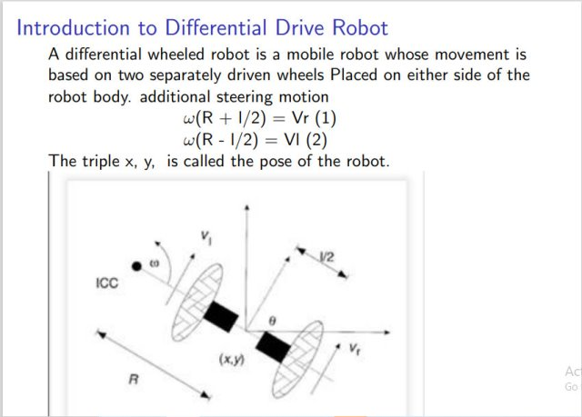

Slide 3
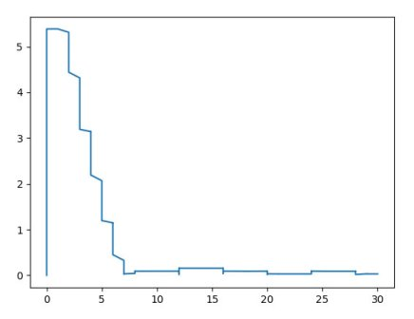
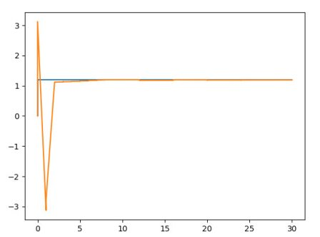
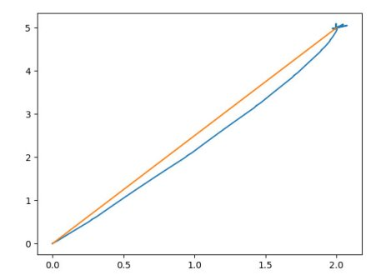
Plots for straight line(Open Loop Control)
Figure 1 . X vs Y
Figure 2.
Time vs Distance error
Figure 3
Time vs Orientation
Orange line shows the reference point and blue line shows the actual bots position.Since we are controlling the bot using open loop control the errors are high

Slide 4
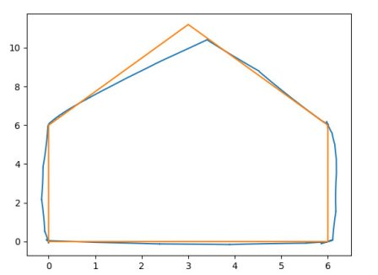
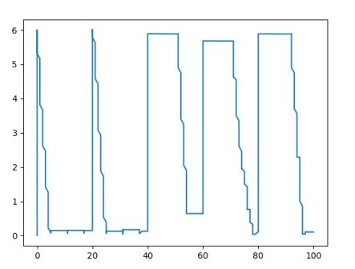
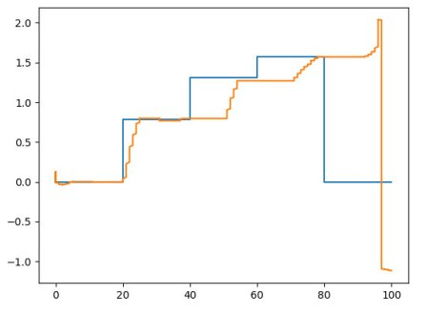
Moving the bot in Pentagon(Open loop control)
https://drive.google.com/file/d
Figure 5
Time vs Distance error
Figure 6
Time vs Orientation
Figure 4.X vs y
https://drive.google.com/file/d/152w9dbwG6d1LaoGLmo9Ve3Lqs4ogHih8/view?usp=sharing
Errors are High Because
of Open loop Control

Slide 5
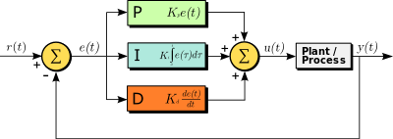
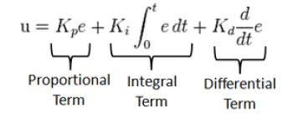
PID CONTROL OF DIFFERENTIAL DRIVE ROBOT
Proportional Action-. Increasing the P gain KP typically leads to shorter rise times, but also larger overshoots.
Integral Action: Increasing the I gain KI, leads to reduction of the steady-state error (often elimination)
Collective Action:Each one of them aims to offer a desired response characteristic (e.g. faster response, damped and smooth oscillations, near-zero steady-state error) but at the same has a negative effect which has to be compensated by re-tuning another gain

Slide 6
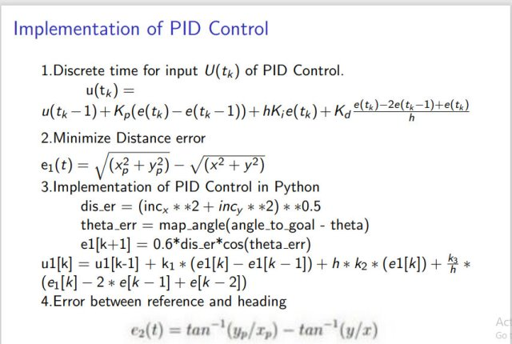

Slide 7
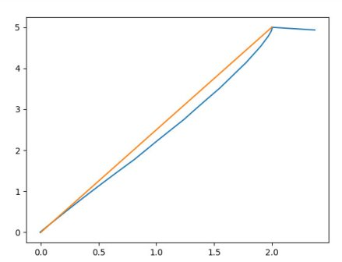
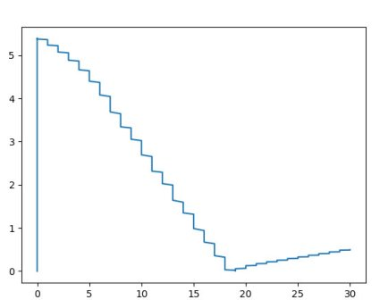
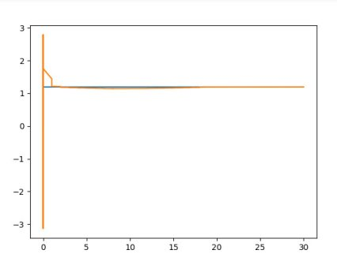
Moving the bot in straight line with P Controller
Figure 7 X vs Y Plot
Figure 8
Time vs Distance error
Figure 9
Time vs Orientation

Slide 8
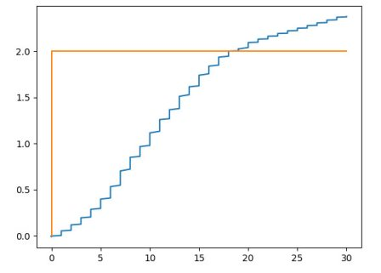
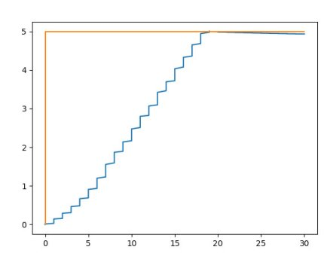
Moving the bot in straight line with P Controller
TIME vs X PLOT
Figure 10 TIME vs X PLOT
Figure 11.TIME VS Y PLOT

Slide 9
Observations (P controller)
With Proportional Gain (Kp =1) ,steady state error is 0.399 (X vs Time)
With Proportional Gain (Kp =4) ,steady state error is 0.345 (X vs Time)
With Proportional Gain (Kp =10) ,steady state error is 0.069 (X vs Time)

Slide 10
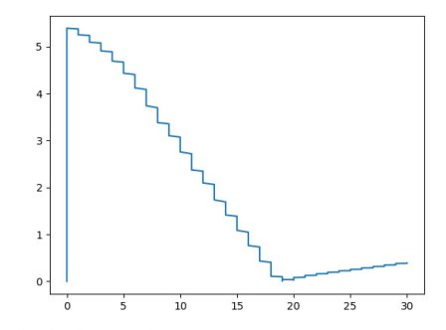
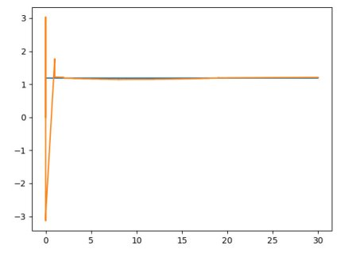
Plots of moving a bot in straight line with PI Controller
Figure 12 X vs Y
Figure 13
Time vs Distance error
Figure 14
Time vs Orientation

Slide 11
Plots of moving a bot in straight line with PI Controller
Figue 15 TIME VS X
Figure 16 TIME VS Y

Slide 12
Observations(PI Controller)
With Proportional and Integral Gain (Kp =1 & KI = 2) ,Steady state error is 0.348
( Y vs Time)
With Proportional and Integral Gain (Kp =1 & KI = 3) ,steady state error is 0.191(Y vs Time)

Slide 13
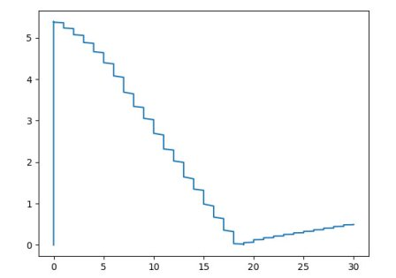
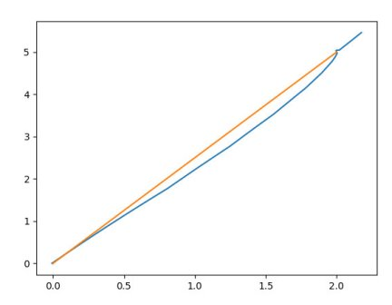
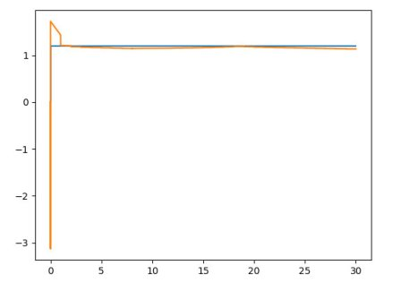
Plots of straight line with PID Controller
Figure 17.X vs Y
Figure 18
Time vs Distance error
Figure 19
Time vs Orientation

Slide 14
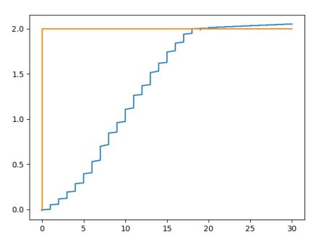
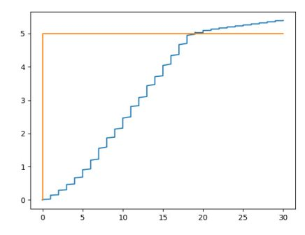
Plots of straight line with PID Controller
Figure 20.TIME VS X
Figure 21.TIME VS Y

Slide 15
Observations(PID Controller)
With Proportional ,Integral and Derivative Gain (Kp =1 & KI = 2 & K d = 0.4) ,Steady state error is 0.196
With Proportional ,Integral and Derivative Gain (Kp =1 & KI = 5 & Kd = 1.1) ,Steady state error is 0.106
With Proportional ,Integral and Derivative Gain (Kp =1 & KI = 5 & Kd = 1.12) ,steady state error is 0.066

Slide 16
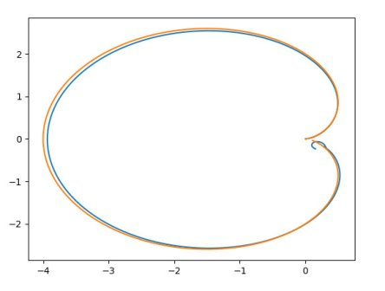
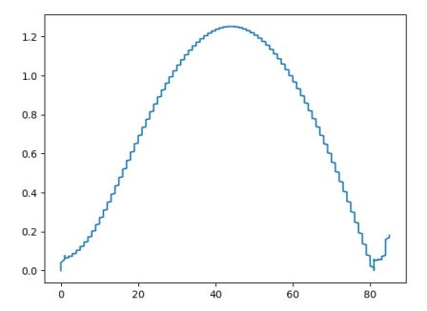
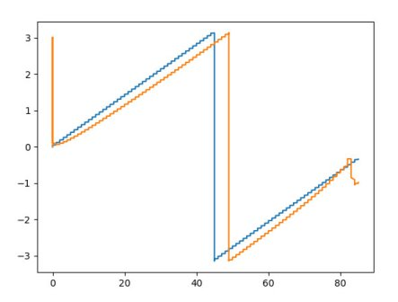
Plots and Observations of Cardioid with PID Controller
Maximum Distance error is 1.2 units
Figure 23
Time vs Distance error
Figure 24
Time vs Orientation
Figure 22. X vs Y
https://drive.google.com/file/d/1z7PsGeD6UjcUuQlIQ6BrtSwgyRIV-kex/view?usp=sharing

Slide 17
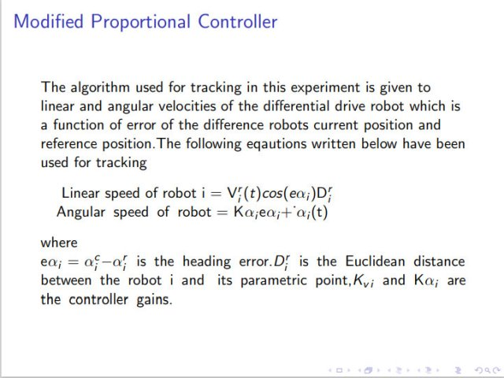

Slide 18
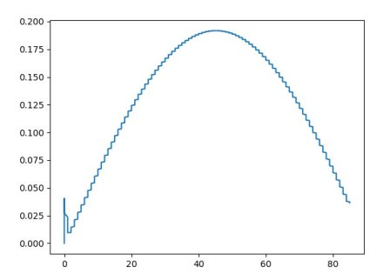
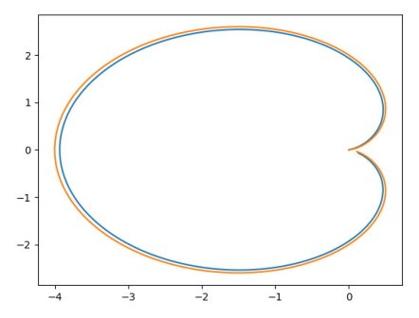
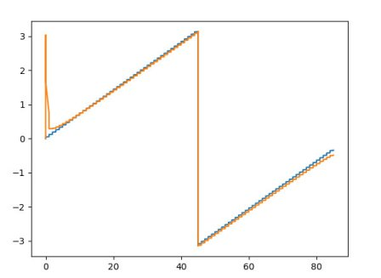
Plots and Observations from Modified Proportional Controller
Figure 23.X vs Y
Maximum Distance error = 0.2 units
Figure 24.
Time vs Distance error
Figure 25
Time vs orientation
https://drive.google.com/file/d/1goXY07-e-L2y5BMa3floDXAln7Y2h-72/view?usp=sharing

Slide 19
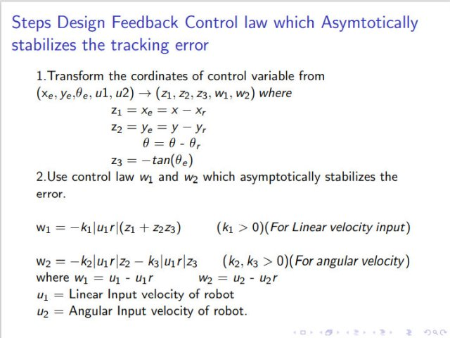

Slide 20
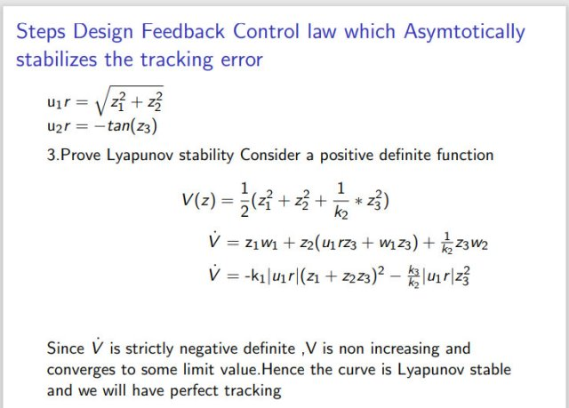

Slide 21
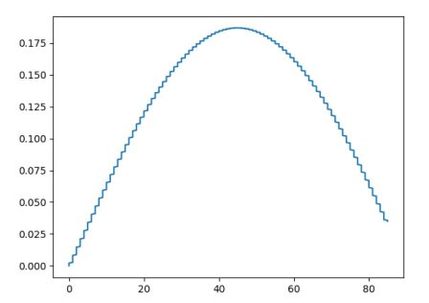
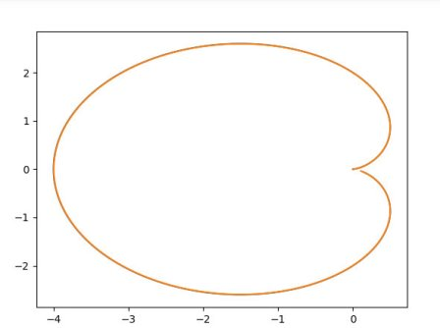
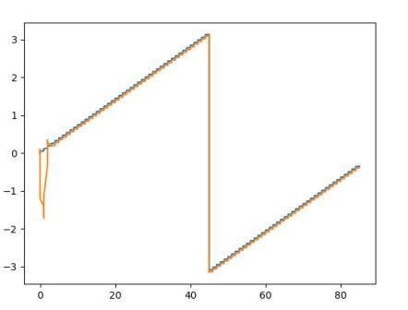
Feedback control Law Plots and Observations of cardiod
Figure 27.
Time vs Distance error
Figure 26.X vs Y
Maximum Distance error = 0.175
Figure 28
Time vs Orientation
https://drive.google.com/file/d/1yBstKxp2ZtnSdnFe6XzyKyAr4qrHt5yt/view?usp=sharing

Slide 22
Thank you

